Slide 1
mmSubArray: Enabling Joint Satellite and Terrestrial Networks in Millimeter-wave Bands
Rohith Reddy Vennam, Ish Kumar Jain, Nagarjun Bhat, Suriyaa M, Luke Wilson, Dinesh Bharadia

Slide 2




Terrestrial networks (5G)
We have more smart phones than people in the world (>8B), highlights the importance for connectivity and accessibility.
Terrestrial networks such 5G offers a high speed and low latency link to vast number of users.
High speed and low latency links
5G link
5G Base
station
User with active 5G connection
5G base station coverage area

Slide 3

Terrestrial networks: Coverage is limited
Terrestrial networks’ coverage is limited to few km
High speed and low latency links
Limited coverage
Link failure
5G Base
station
User waiting for connection
5G base station coverage area
No coverage area

Slide 4

Satellite direct-to-device connectivity
With latest advancements in smartphones and LEO satellites, terrestrial devices can now directly connect to satellites
Ex: Starlink direct-to-cell connectivity
Ubiquitous coverage
Satellite
Satellite direct-to-device link
5G Base
station
Satellite direct-to-device connectivity
5G base station coverage area
Satellite enabled coverage
Ref: starlink.com/business/direct-to-cell

Slide 5
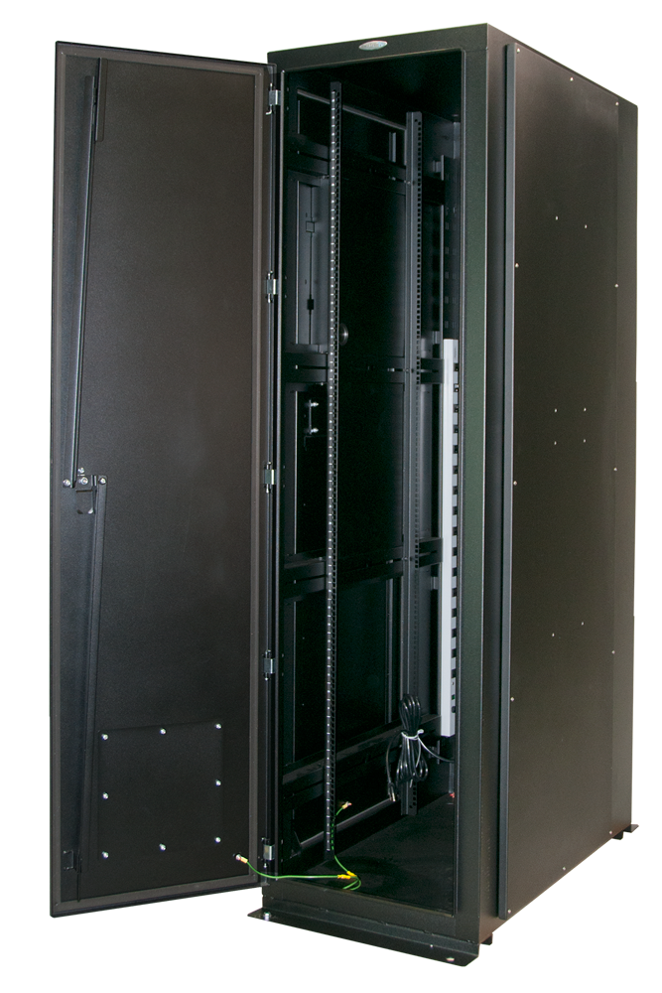

Satellite direct-to-device connectivity: challenges
Satellite
The link between satellite and terrestrial operator network is the bottleneck due to the disjointness between both networks.
Ubiquitous coverage
Long fiber backhaul
Not scalable
5G Base
station
Satellite direct-to-device link
Long fiber backhaul to operator network
Terrestrial operator
network
Ground station
5G base station coverage area
Satellite enabled coverage
Ref: starlink.com/business/direct-to-cell

Slide 6
Proposed Joint satellite and terrestrial networks (JointNets)
Avoid fiber backhaul and join satellite ground stations and 5G base stations
Satellite
Ubiquitous coverage
Wireless backhaul
JointNets: High speed mmWave Backhaul link between satellite ground station and 5G base station
Scalable
5G Base
station
Satellite direct-to-device link
Terrestrial operator
network
Ground station
5G base station coverage area
Satellite enabled coverage

Slide 7

Two requirements for JointNets
Enable Backhaul
Satellite
Enable wireless backhaul and join satellite and terrestrial networks
High speed wireless
mmWave backhaul
Satellite Link
Direct to device
5G Link
Enable coexistence
Both networks should operate without affecting each other, even when they are nearby and using the same frequency bands.
5G Base
station
User within 5G coverage
Remote user
Ground station
5G base station coverage area

Slide 8
JointNets challenge: Interference
When a satellite ground station and a 5G base station are in proximity and use overlapping frequency bands, it can lead to interference issues
Ground stations transmit uplink signals in the 27.5-30 GHz band with high transmit power. Further, unlike GEO satellites, LEO satellites move rapidly, requiring frequent dish realignment and causing sidelobe leakage.
These can lead to significant interference at 5G base stations, resulting in poor signal-to-noise ratio (SNR) or link failures.
Ground station to satellite uplink transmission leakage towards 5G base station leading to co-channel interference
Satellite
Satellite
Uplink leakage (undesired)
Direct to device
Satellite
Uplink (desired)
5G Link
High speed wireless
mmWave backhaul
5G Base
station
User within 5G coverage
Remote user
Ground station
5G base station coverage area

Slide 9
Interference: Co-channel and Adjacent channel
Co-channel Interference
When multiple sources transmit in overlapping frequency bands.
Interference power increases the noise floor, resulting in poor signal-to-noise ratio (SNR) or may cause link failure.
Adjacent channel interference
When there is a simultaneous transmission in the adjacent channel.
Adjacent channel interference increases dynamic range on the receiver, there by degrading step size and leading to increase in quantization noise.
Desired band/channel
Desired band/channel
Notes:
Q)Are in-band and co-channel interference same?

Slide 10
Current approaches to address interference (when nearby)
Approach | Full Spectrum Usage (Co-existence) | Coverage gaps (Coexistence) | Enabling backhaul | Comments
Frequency separation (Filtering) |  |  |  | Significant wastage of spectrum (full overlap can lead to 100% wastage)
Direction Separation (Beam nulling) |  |  |  | Effective spectrum usage but creates coverage gaps and cannot backhual
How to enable backhaul and coexistence
while fully utilizing spectrum and avoiding coverage gaps?

Slide 11
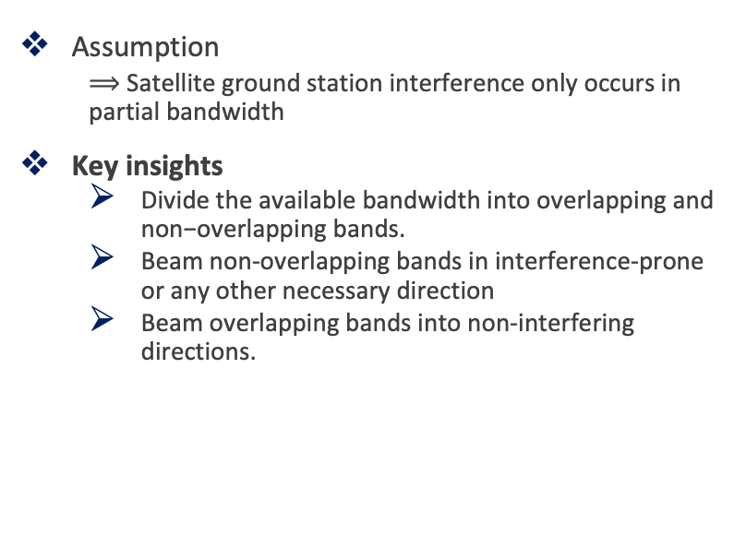
Our approach: key insights
Assumption
$⟹$ Satellite ground station interference only occurs in partial bandwidth
Key insights
$\text{Divide} \text{the} \text{available} \text{bandwidth} \text{into} \text{overlapping} \text{and} \text{non}\text{−}\text{overlapping} \text{bands}\text{.}$
Beam non-overlapping bands in interference-prone or any other necessary direction
Beam overlapping bands into non-interfering directions.
Serving users in non-interfering directions with overlapping band using phased array-1
Frequency
Non-overlapping band
Direction
Overlapping band
Supporting users in the interference direction within the non-overlapping band using Phased Array-2
Frequency
Notes:
Requirements
$⟹$Full spectrum usage requires efficient usage of full bandwidth
$⟹$No coverage gaps mandates ability to serve users in all directions

Slide 12
Fundamental problem with phased array
Phased array
Beams full bandwidth in one direction
It cannot split and beam in different directions
Frequency
Notes:
Requirements
$⟹$Full spectrum usage requires efficient usage of full bandwidth
$⟹$No coverage gaps mandates ability to serve users in all directions

Slide 13
Proposed mmSubArray solution
mmSubArray approach
Divide overall bandwidth into multiple overlapping and non overlapping bands
Use different phased arrays for each
Satellite
Non-overlapping band
Overlapping band
Hz
Hz
Satellite Link
Direct to device
5G Link
5G Base
station
High speed wireless
mmWave backhaul
User within 5G coverage
Remote user
Ground station
5G base station coverage area

Slide 14
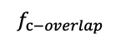
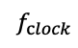
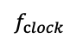
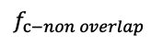
Proposed mmSubArray solution: Beaming non-overlapping band to satellite ground station
Non-overlapping band
Frequency
$$f_{clock}$$
Phased Array
SDR
$$f_{c−non overlap}$$
Gain
Ground station
$$f_{c−overlap}$$
Gain
Phased Array
$$f_{clock}$$
Enabling backhaul through non-overlapping band
mmSubArray

Slide 15
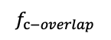
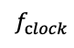
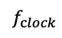
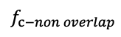
Proposed mmSubArray solution: Suppressing interference and supporting users
Overlapping band
Frequency
$$f_{clock}$$
Beaming in non-interfering angles
Phased Array
SDR
$$f_{c−non overlap}$$
Gain
$$f_{c−overlap}$$
Gain
Phased Array
Beaming nulling to suppress below noise floor
$$f_{clock}$$
user
mmSubArray
Enabling coexistence by suppressing interference and effectively supporting users in non interfereing directions

Slide 16
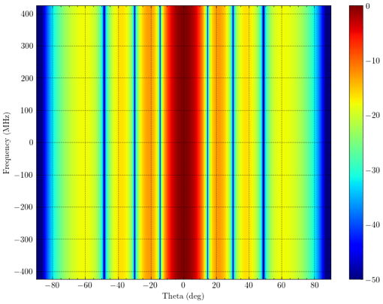
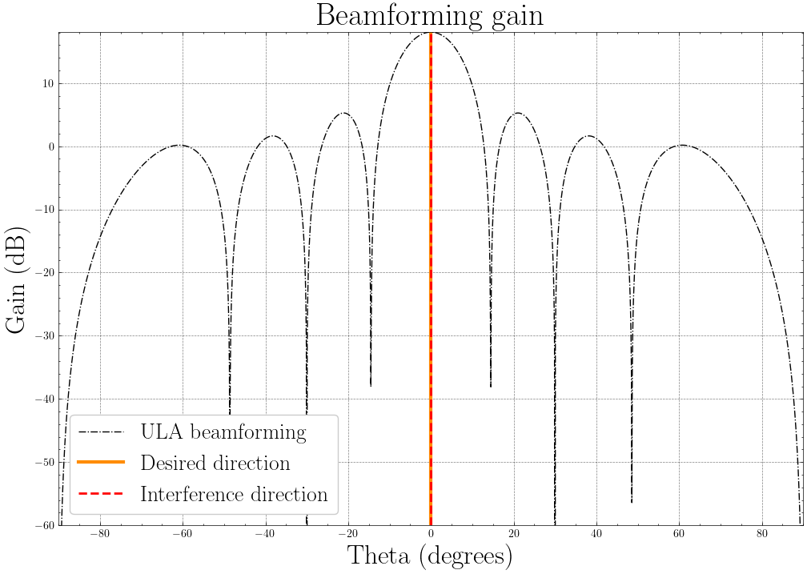
Simulator Results: Beamforming in frequency and space
Beamforming gain in space domain
Beamforming gain in frequency and space domain

Slide 17
Simulator Results: Splitting and Nulling
Supporting user in interferer directions
Splitting: Supporting users in non-interferer directions
Splitting + Nulling: Supporting users in non-interferer directions with nulling

Slide 18
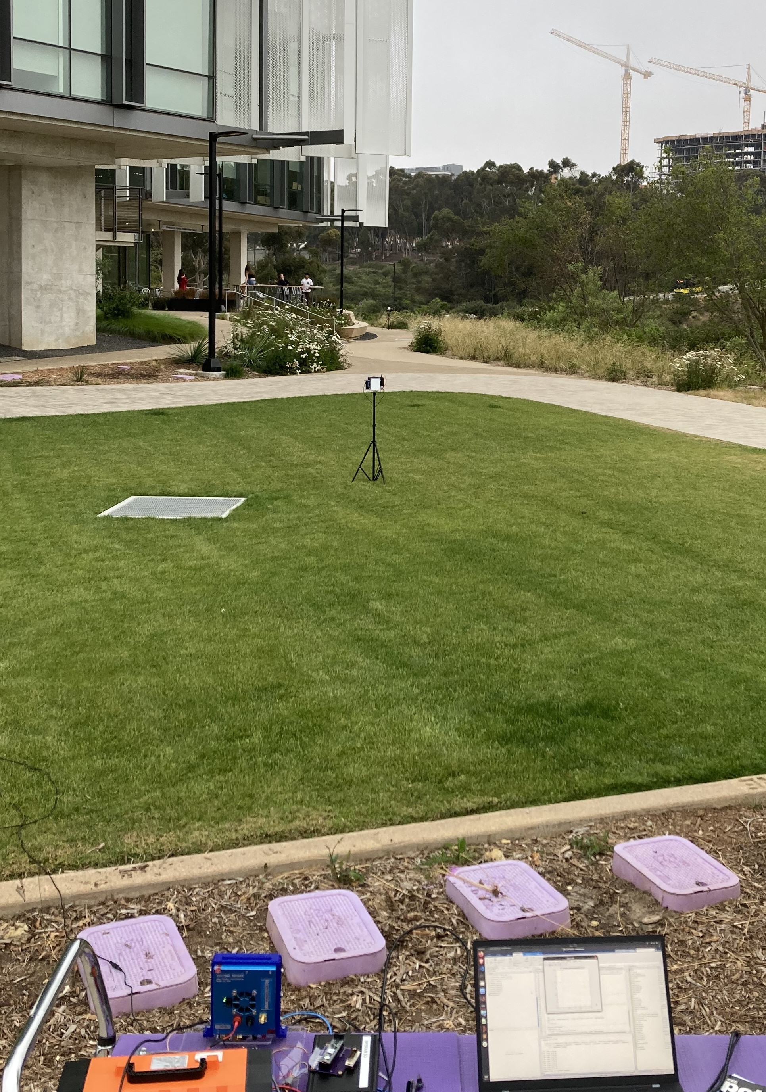

Over-the-air experiments: Hardware Setup
Hardware setup with commercial phased arrays mimicking 5G user (UE), Interferer and Base station
UE
Interferer
5G Base Station
18

Slide 19
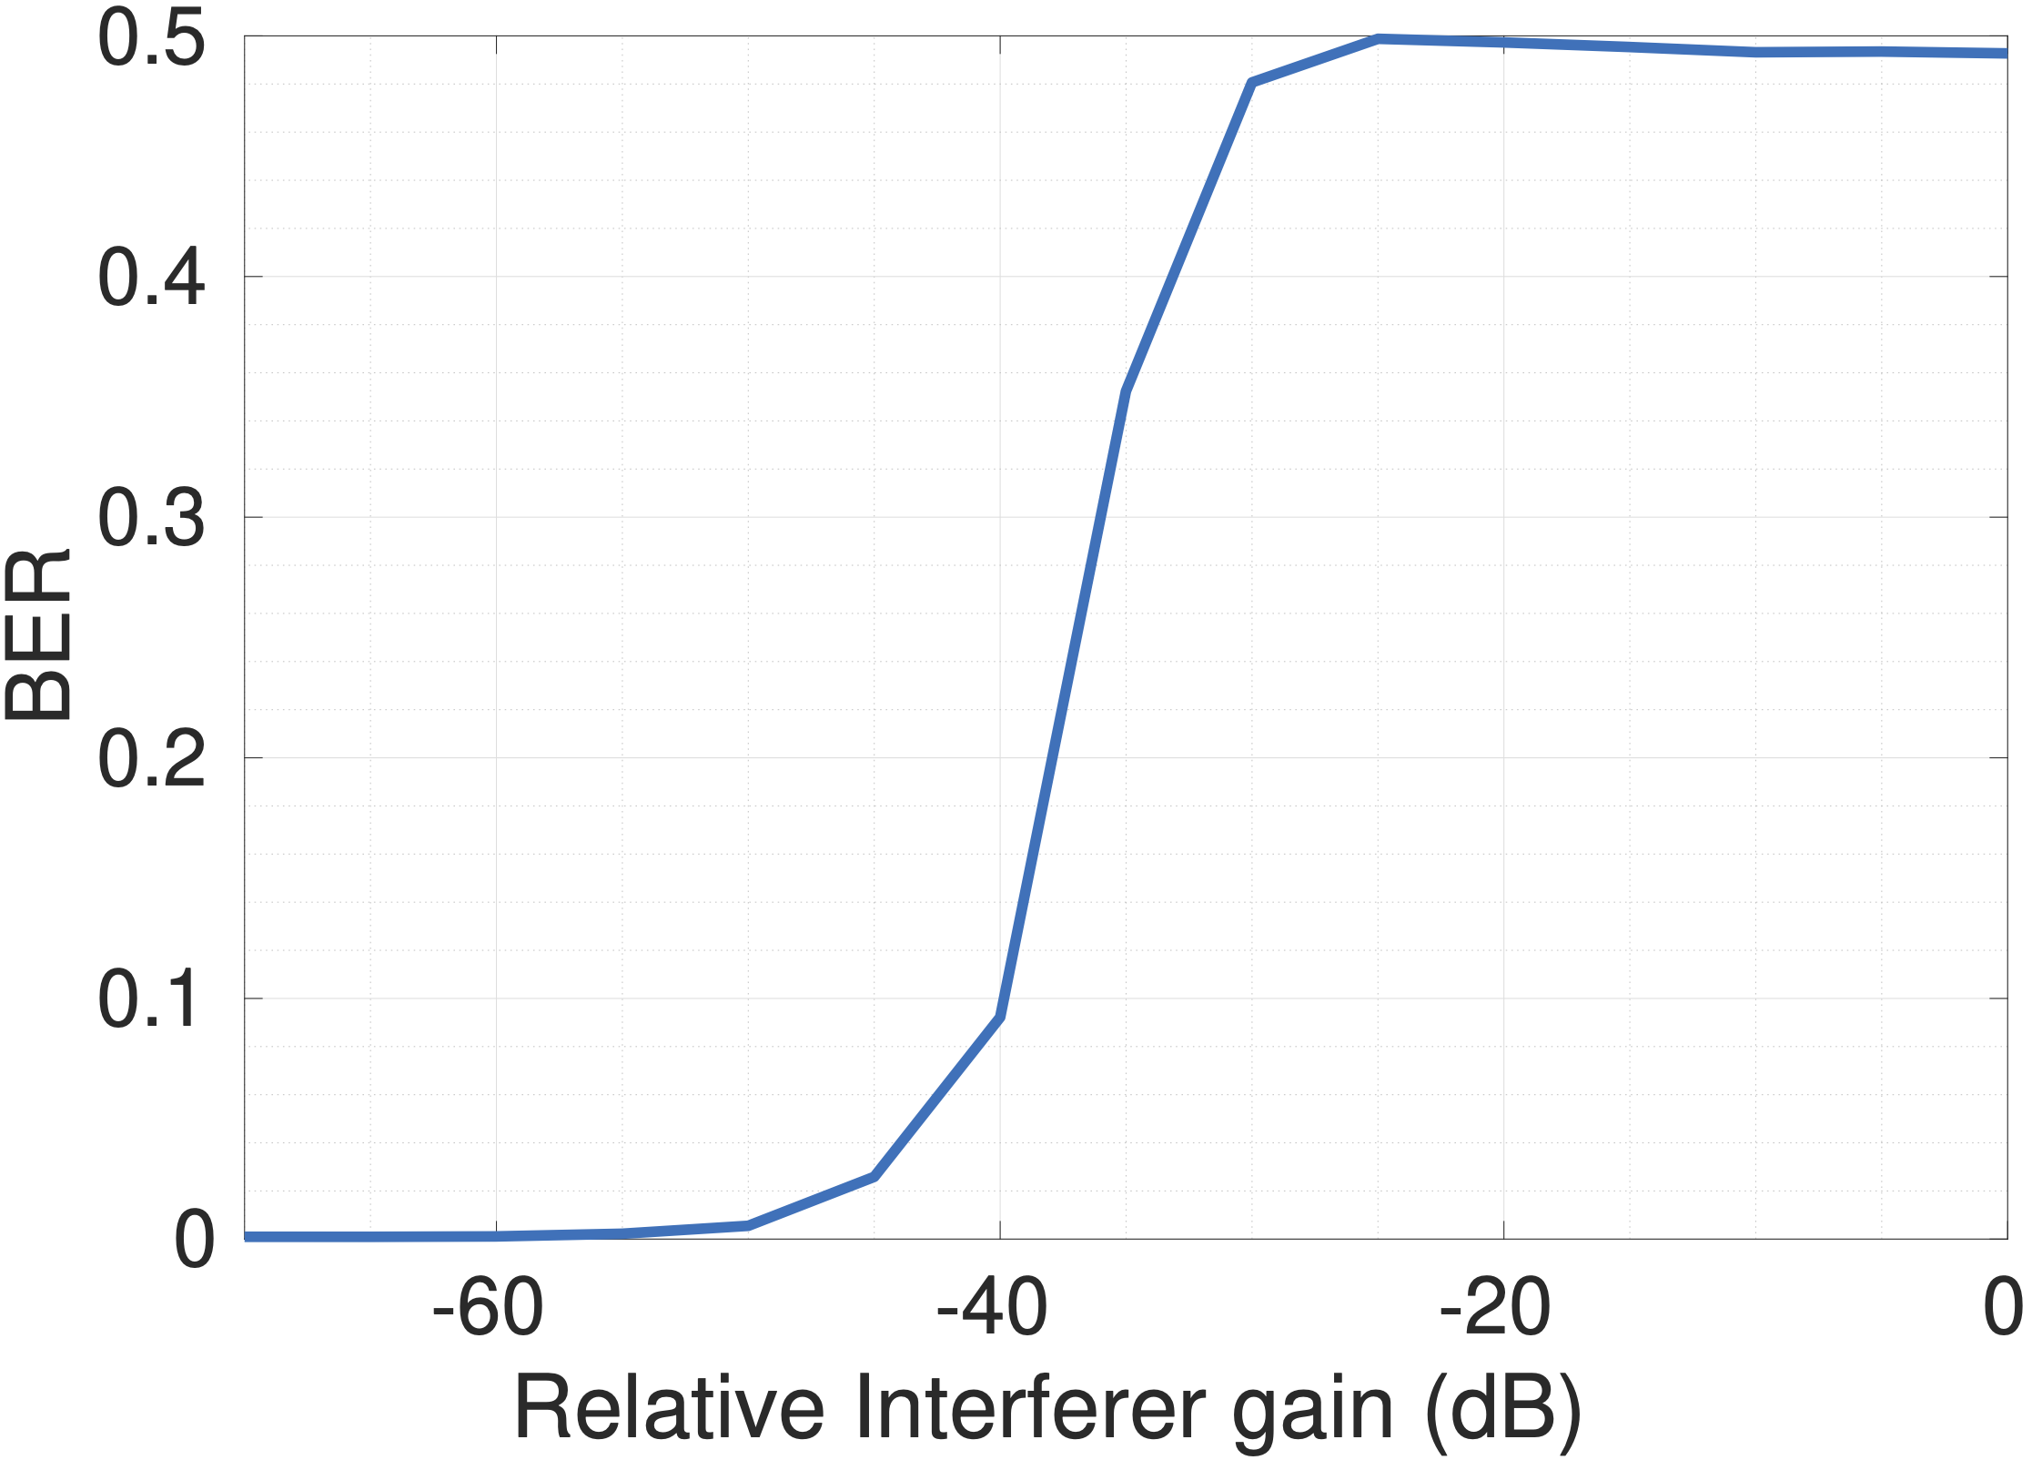
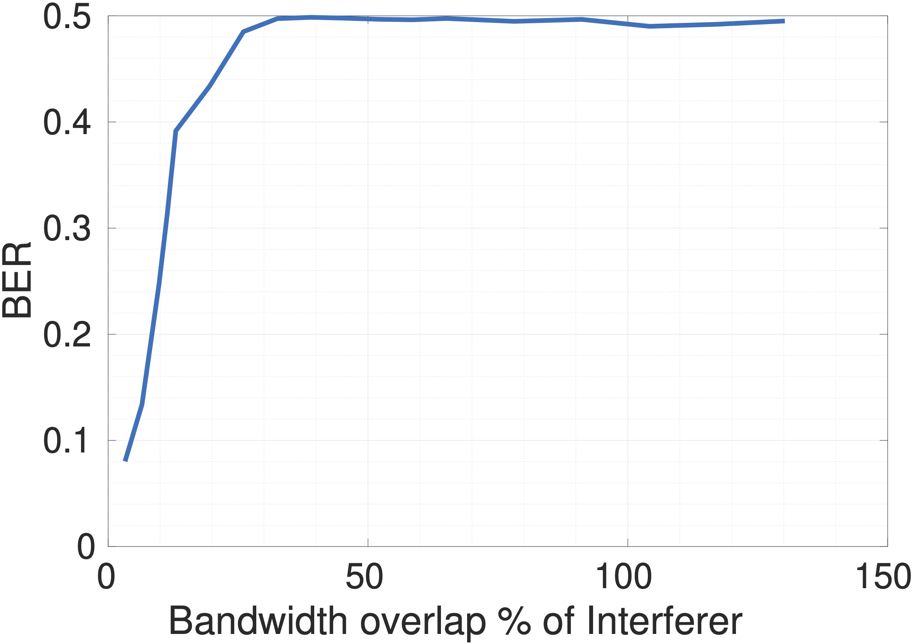
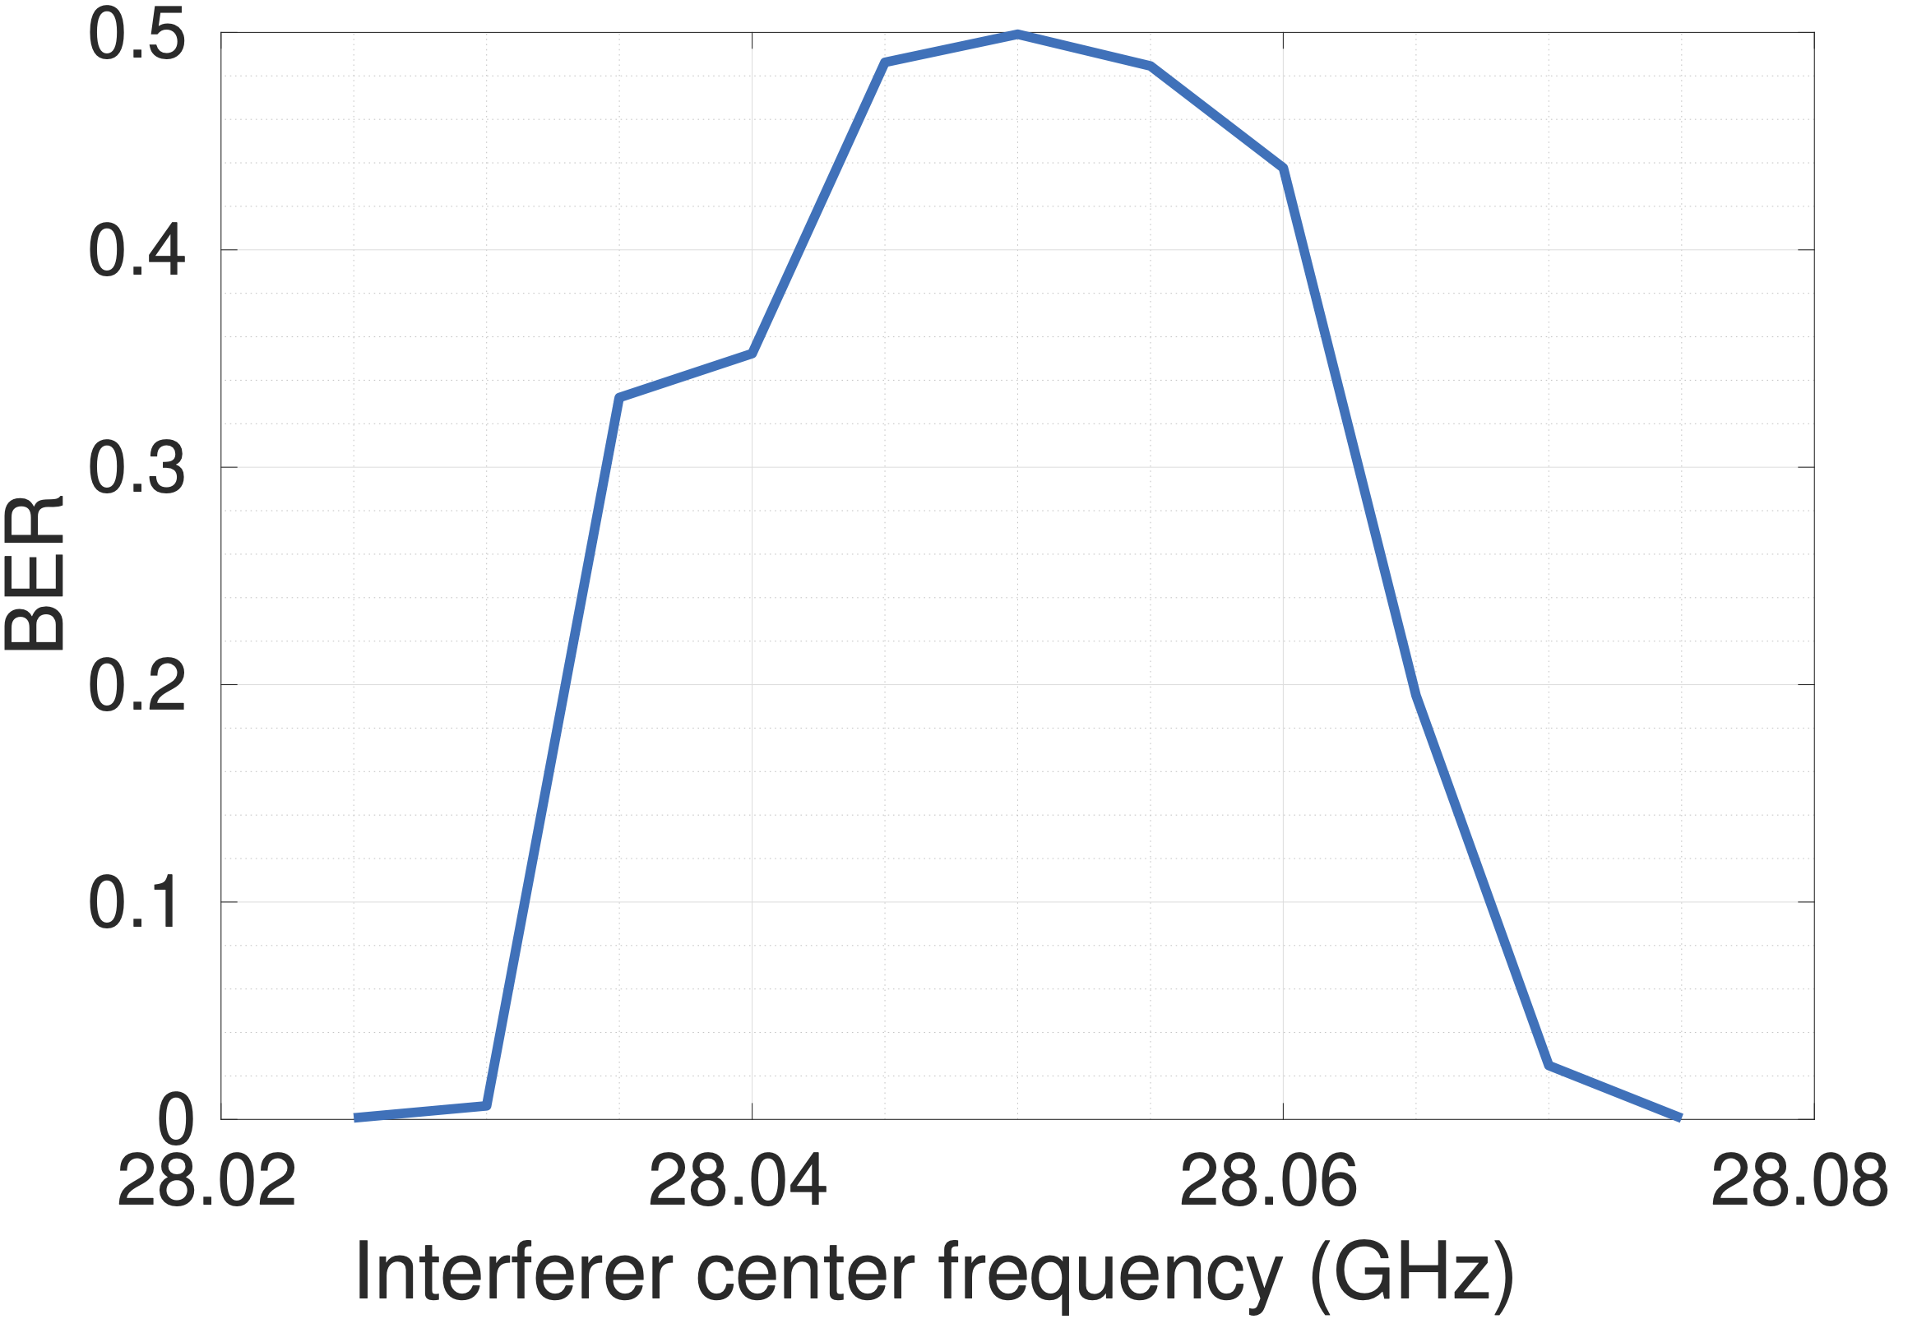
Over-the-air experiments: Results
Suppressing interference below the noise floor enables coexistence in overlapping bands
Partial overlap (>25%) results in similar degradation as full bandwidth overlap
Adjacent channel Interference does not significantly affect the link performance
A non-overlapping band only experiences adjacent channel interference, which remains unaffected and helps in enabling backhaul

Slide 20
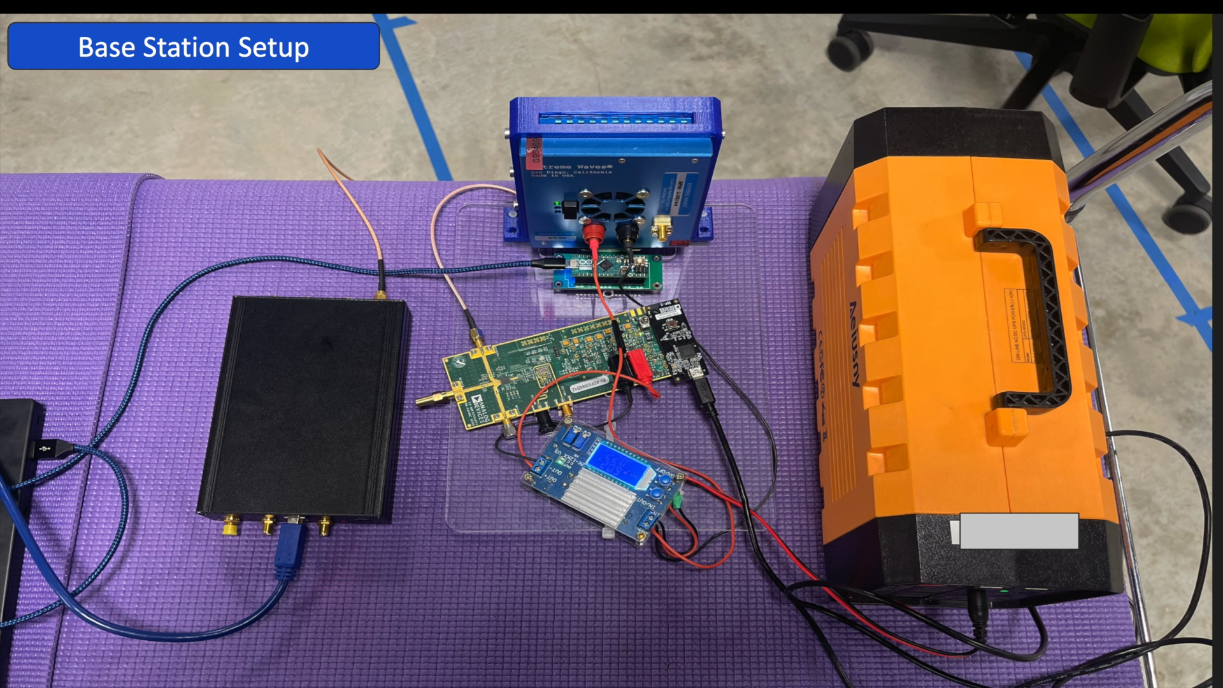
mmSubArray Prototype: Demo video
mmSubArray suppresses interference in overlapping bands by beaming in non-interfering directions and applying nulling

Slide 21
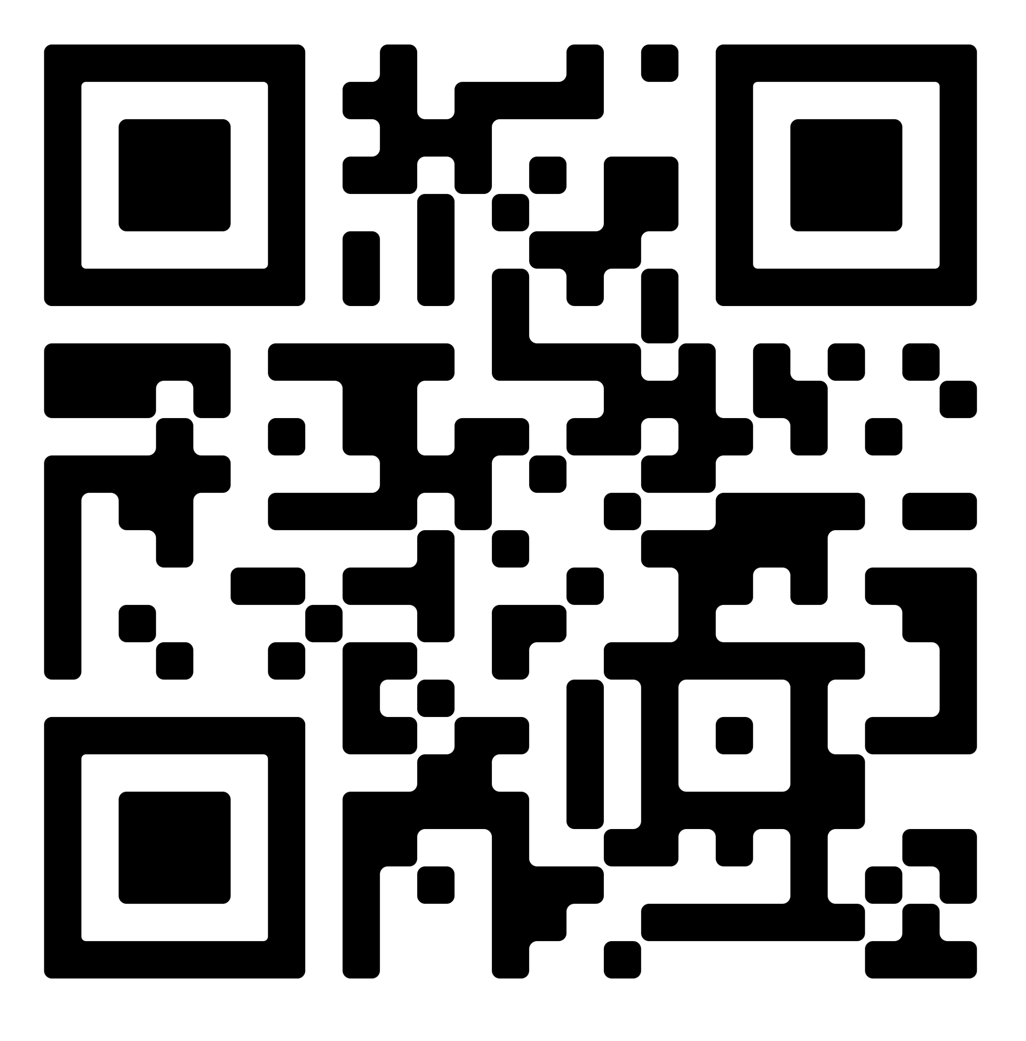
mmSubArray Enables JointNets
High speed wireless mmWave backhaul – no more expensive fiber backhual.
Ensures Coexistence - suppress interference and support users effectively.
Achieves high spectral efficiency on both networks and avoid coverage gaps.
Satellite
Artifacts and more details at
Satellite Link
Direct to device
wcsng.ucsd.edu/ mmsubarray
5G Link
High speed wireless
mmWave backhaul
Questions?
5G Base
station
User within 5G coverage
Remote user
Ground station

Slide 22
Additional slides

Slide 23
Current approaches to address interference: Frequency Separation (Filtering)
Satellite uplink and 5G links are in different frequency bands, discarding overlapping bands and only use non-overlapping bands for 5G links
Satellite
Spectrum wastage
No coverage gaps
Integrates Satellite and 5G Networks
5G Link
Satellite
Uplink (desired)
Satellite uplink
Direct to device
Wireless
mmWave backhaul
5G Base
station
User within 5G coverage
Remote user
Ground station
5G base station coverage area

Slide 24

Current approaches to address interference: Angle Separation (Beam nulling)
5G Base station uses phased array to do beam nulling, this approach suppress all frequencies in nulling direction, thereby by nullifying interference effect.
Satellite
Full spectrum usage
Coverage gaps
Satellite
Uplink leakage (undesired)
Cannot integrate Satellite and 5G
Direct to device
Satellite
Uplink (desired)
5G Link
5G Base
station
User within 5G coverage
Remote user
Ground station
5G base station coverage area

